Slide 1
CobaltStrike External C2 via Microsoft Teams
Leveraging Microsoft Graph API For CobaltStrike Beacon Communications

Slide 2

WHOAMI
Alex Reid
OSCP, OSEP, RTJC
Red Teamer and Tool Developer
~2.5 years in cyber / red teaming / development
2x contributor to CobaltStrike Community Kit
Interested in Windows malware development and exploitation
Primarily develop in C, work in Python3 / Powershell when the opportunity arises
GitHub: https://github.com/Octoberfest7

Slide 3
What is External C2?
“External C2 is a specification to allow third-party programs to act as a communication layer for Cobalt Strike’s Beacon payload”¹
Abstraction of the network portion of CobaltStrike
Keep the CobaltStrike GUI, keep all of the features and functions of Beacon, change how Beacon data gets to the Teamserver.
External C2 goes far beyond traffic customization possible in Malleable Profile
MP allows operator to obfuscate beacon data in GET/POST requests to an attacker controlled IP/Domain (set in Listener)
External C2 goes deeper, leveraging a third-party platform (usually their API) to transmit Beacon data. Too complex for MP, requires custom tooling
1. https://hstechdocs.helpsystems.com/manuals/cobaltstrike/current/userguide/content/topics/listener-infrastructue_external-c2.htm

Slide 4
Why External C2?
The “best” solution is having a custom in-house C2
Commercial and/or public C2’s are highly signatured
But developing a mature in-house C2 is VERY costly both in time and resources
External C2 allows deep customization of the network layer while leveraging a full featured, mature implant.
Customization of the network layer of C2 can pay significant dividends
Domain reputation
Endpoint telemetry
Network proxy’s and whitelists

Slide 5
A Quick Note on Other’s Work…
Lots of examples of External C2 and related work publicly available
F-Secure / WithSecureLabs C3²
Framework to leverage different communications channels
Mattermost, Asana, GitHub, Dropbox, JIRA, Discord, GoogleDrive, Slack, EWS Tasks, OneDrive 365, MSSQL, UNC Share File, LDAP, Printer Jobs
Boku7 azureOutlookC2³
Utilizes Microsoft Graph API for C2 via Outlook Mailbox, but not an External C2; standalone implant
2. https://labs.withsecure.com/tools/c3
3. https://github.com/boku7/azureOutlookC2

Slide 6
Why Teams?
Lots of third-party apps out there, why Teams?
Want a communication channel common to as many organizations as possible; Slack, Mattermost, GitHub are all popular but may be out of place depending on target
An organization may not use Teams, but they almost assuredly use Windows
Windows has all kinds of processes, both background and user-driven, that frequently communicate with Microsoft owned domains/resources
This makes it very hard for organizations to block or discriminate against HTTPS traffic headed to Microsoft owned resources; very easy to break things.
Abuse this inherent trust in order to get C2 traffic out of the network without raising suspicion
Avoids lots of problems encountered by conventional C2 related to domain reputation, network proxies, domain whitelisting, etc.

Slide 7
What is Graph API?
“Microsoft Graph is a RESTful web API that enables you to access Microsoft Cloud service resources. After you register your app and get authentication tokens for a user or service, you can make requests to the Microsoft Graph API.”⁴
Key Point: This project is NOT leveraging or impacting a target’s Teams environment or Azure AD account! All calls to Graph API are made to an attacker-owned AAD/O365 instance!
Graph allows you to interact with far more than Teams; Outlook, SharePoint, OneDrive, Excel, etc.
This project happens to send Beacon traffic via Teams messages, but it’s the Graph API being leveraged to do so; instead of Teams, could have used different API’s in the same framework to send C2 traffic via Outlook drafts a la Boku7’s azureOutlookC2.
External C2 traffic is sent to graph.microsoft.com; NOT teams.microsoft.com
4. https://learn.microsoft.com/en-us/graph/use-the-api

Slide 8
Graph API and Threat Actors
Graph API malware has been utilized by and attributed to nation-state sponsored APT’s
BLUELIGHT
APT 37 / InkySquid / ScarCruft – North Korea⁵
Custom C2, utilizes Graph to communicate with OneDrive
Graphite
APT 28 / Fancy Bear – Russia⁶
Custom C2, utilizes Graph to communicate with OneDrive
5. https://www.volexity.com/blog/2021/08/17/north-korean-apt-inkysquid-infects-victims-using-browser-exploits/
6. https://www.trellix.com/en-gb/about/newsroom/stories/research/prime-ministers-office-compromised.html

Slide 9
Key Considerations
We are now leveraging a third-party application/service for C2
Attacker’s no longer control the “redirector/webserver”
Cannot implement IPTables / Apache mod_rewrite / otherwise restrict access to attacker-environment in the same way
Most services will use an auth token of some kind in order to utilize API; implant must contain ID’s/secrets/tokens in order to communicate with service. If defenders get your implant, they can authenticate to your environment in the third-party application!
Third-party likely rate-limit requests; you probably aren’t going interactive with your Beacons…
Security of client data
Data is encrypted by Beacon before transmit, but are you comfortable with customer data residing on infrastructure you don’t own?
Asynchronous communications
Beacon and Teamserver are no longer synched by Beacon check-in
Teamserver must reach OUT to third-party app in order to check for Beacon traffic + send response
Another reason you probably aren’t going interactive with your Beacons

Slide 10
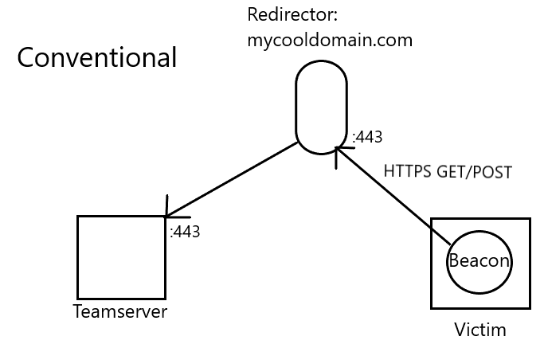
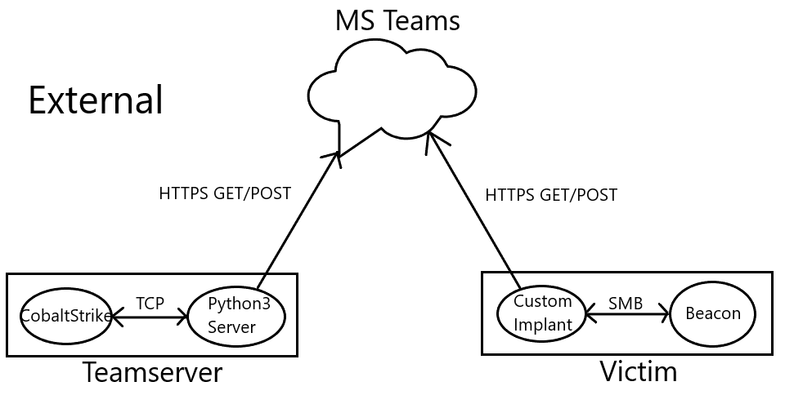
Conventional VS External Illustrated
Excuse the MS Paint artwork…

Slide 11
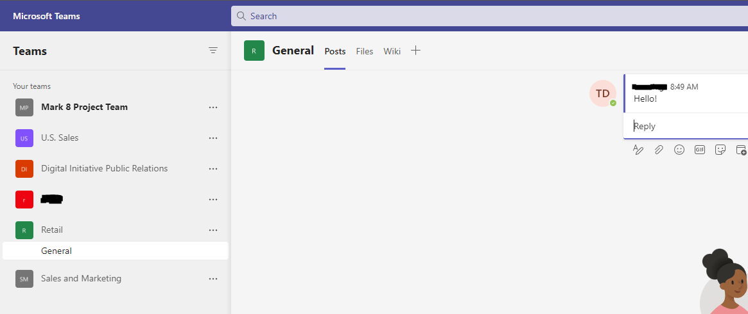
Third Party App Requirements
What are the requirements of a third-party app to be a good fit for External C2?
Receive transmissions from server/implant and be able to differentiate between them
Handle multiple simultaneous Beacon connections
Capable of transmitting large quantities of data (file upload/download, large command output)
Require some kind of authentication / prevent unwanted access to our instance of app

Slide 12
Organizational Structure in Teams
Microsoft Teams Instance
Team A – Mark 8 Project Team
Team B – U.S. Sales
Team C – Retail
Channel 1 – General
Channel 2 – Store A
Message 1 – From User 1
Message 2 – From User 2
etc
Channel 3 – Store B
How does Teams organize data?
How can our Beacon model fit into the Teams data structure?
Team level – An operation / target environment
Channel level – A Beacon
Message level – A check-in from server/implant
Can have many channels per team
Can send a lot of messages in each channel

Slide 13
Infrastructure
We need an attacker-owned/controlled AAD tenant
Will need a plan that includes O365 or M365 access in order to use Teams
Microsoft plans are horribly complex/confusing… do the research into what features you actually need
Implant will be sending Teams messages AS someone; need to make/use user accounts
Need to create an Enterprise Application to utilize Graph API and send requests
Have to grant appropriate rights to App in order for it to use certain API’s
learn.microsoft.com has fantastic documentation on Graph API
Lots of little settings to tweak and configure. Microsoft documentation makes it all possible, just takes some googling and some work.
External C2 requires a pretty extensive commitment; hard to automate components of the infrastructure setup
Creating Tenant, retrieving data that goes into Server / Implant
Even more if you want to go non-attrib and bounce all traffic from attacker through other cloud infra before it touches Microsoft…

Slide 14
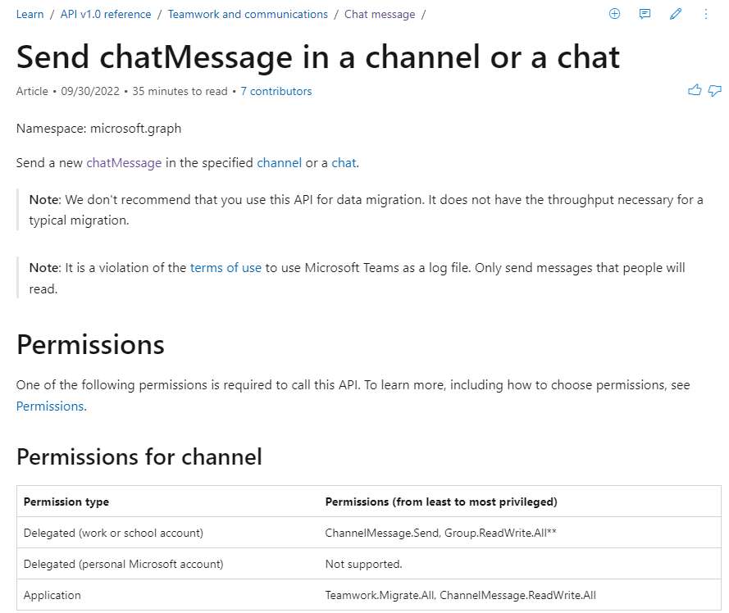
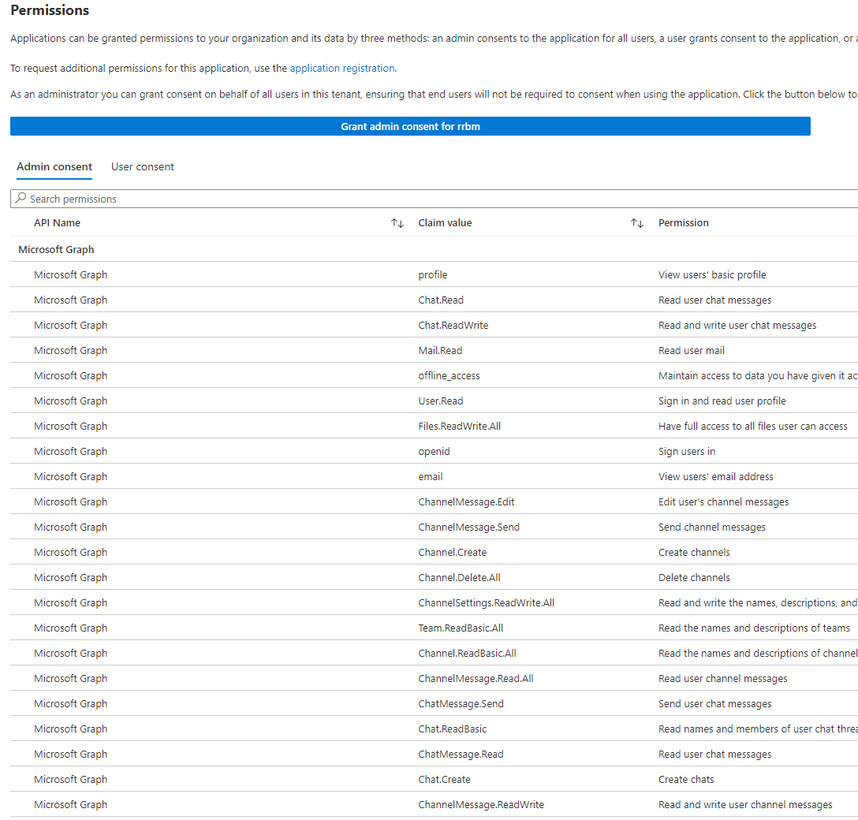
Application Permissions

Slide 15
Implant and Server Overview
Server
Runs on attacker TS box
Python3 - Easy to write, no env restrictions
Interpreter/handler between Teams and TS
Authenticate to Teams
Retrieve messages from Teams
Parse messages
Send data to TS -> receive response from TS
Format TS data into Teams messages
Send TS response to Teams
Implant
Runs on victim machine
C - utilizes WinApi, standard malware language
Interpreter/handler between Teams and Beacon
Authenticate to Teams
Retrieve messages from Teams
Parse messages
Send data to Beacon -> receive response from Beacon
Format Beacon data into Teams messages
Send Beacon response to Teams

Slide 16
Authentication
How do Server / Implant authenticate and send messages to Teams?
Graph API utilizes OAuth 2.0
User authenticates to AAD and receives an Access token
Access tokens are short-lived (~1 hour)
Access token is required to send/retrieve data from Teams
User can also request a Refresh token
Refresh tokens are long-lived (~90 days)
Refresh token can be used to request new Access token
Embed Refresh token in Server / Implant
On runtime, fetch new Access token using Refresh token
Every x minutes (before Access token expires), request new Access token -> repeat

Slide 17
Implant Secrets
Implant has to have several pieces of sensitive information hard-coded into it to function:
AAD Tenant ID
Enterprise Application ID
User ID’s
User Refresh token’s
If a competent person got a sample of the Implant they could authenticate to and access your AAD Tenant resources!*
*Depending on your configuration… what permissions are granted to the “user” whose token they have?
Some time should be spent exploring AAD and permissions; ironically least-privilege applies to attackers too!
Take-down requests to Microsoft…

Slide 18
Communications Model
Asynchronous comms; both implant AND server reach out to Teams to “talk”
What do normal CS requests/responses look like?
First check-in from Beacon sends metadata about compromised host
Server no tasking / Beacon no data -> transmit null byte (0x00)
Heartbeat message: “Hey I’m alive”
Tasks / output AES encrypted
External C2
Python server initiates new connection to TS via TCP
TS sends SMB shellcode to Python server
Python server formats shellcode and sends to Teams
Implant checks Teams, finds shellcode, downloads it
Implant parses Teams messages, runs shellcode, connects to Beacon via SMB
Implant retrieves metadata from Beacon, formats it and sends to Teams
Python server checks Teams, finds metadata, downloads it, passes to TS, etc

Slide 19
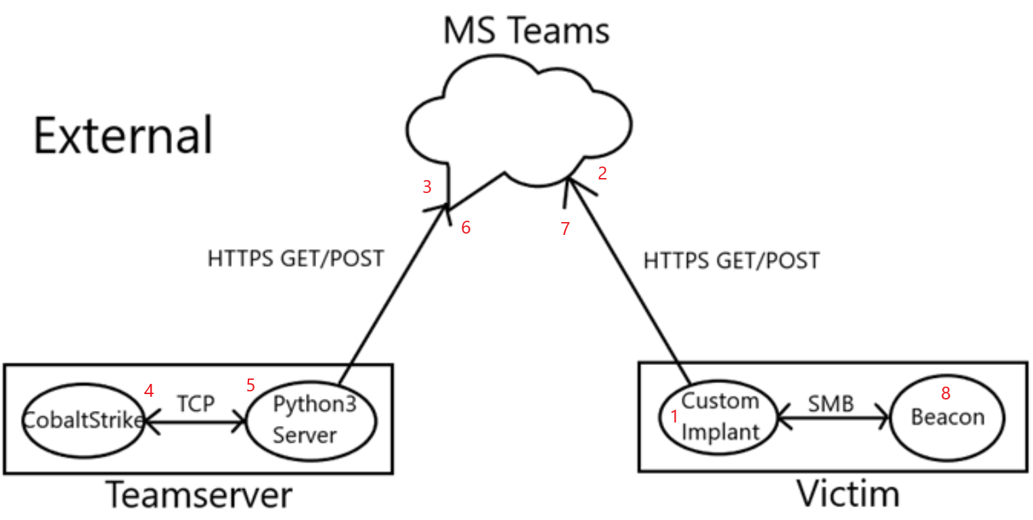
Communications Model
How does Python server know to initiate new TS connection, fetch SC? Where to send data?
Implant executes -> create new channel in Teams
Python server runs continuously, fetching list of channels in Teams
New channel = new implant, initiate new connection to TS + fork process to handle that channel only
Implant Executes
Creates new channel
Server sees channel
New TS connection
Receives shellcode
Server sends shellcode to Teams
Implant reads shellcode from Teams
Implant spawns Beacon

Slide 20
Communications Model
How is data actually sent?
Each time TS / Beacon transmits, Server / Implant sends a Teams message
TS /Beacon data has to be encoded somehow, need a text representation of data -> Base64
How do Server / Implant know whether a message should be processed?
Server / Implant each contain unique user-id’s; send messages as these users
Fetch last message -> Does the user-id match mine? If so, sleep. If not, it’s the other guy, get it
Teams message format / restrictions
Can only fit ~16K bytes in each Teams message
What if TS / Beacon has 250K in data to send?
Need multiple messages…
Data model:
When TS / Beacon transmits, send a Teams message
Any actual Data is sent as replies to TS’s / Beacon’s own message
250K/16K = number of replies

Slide 21
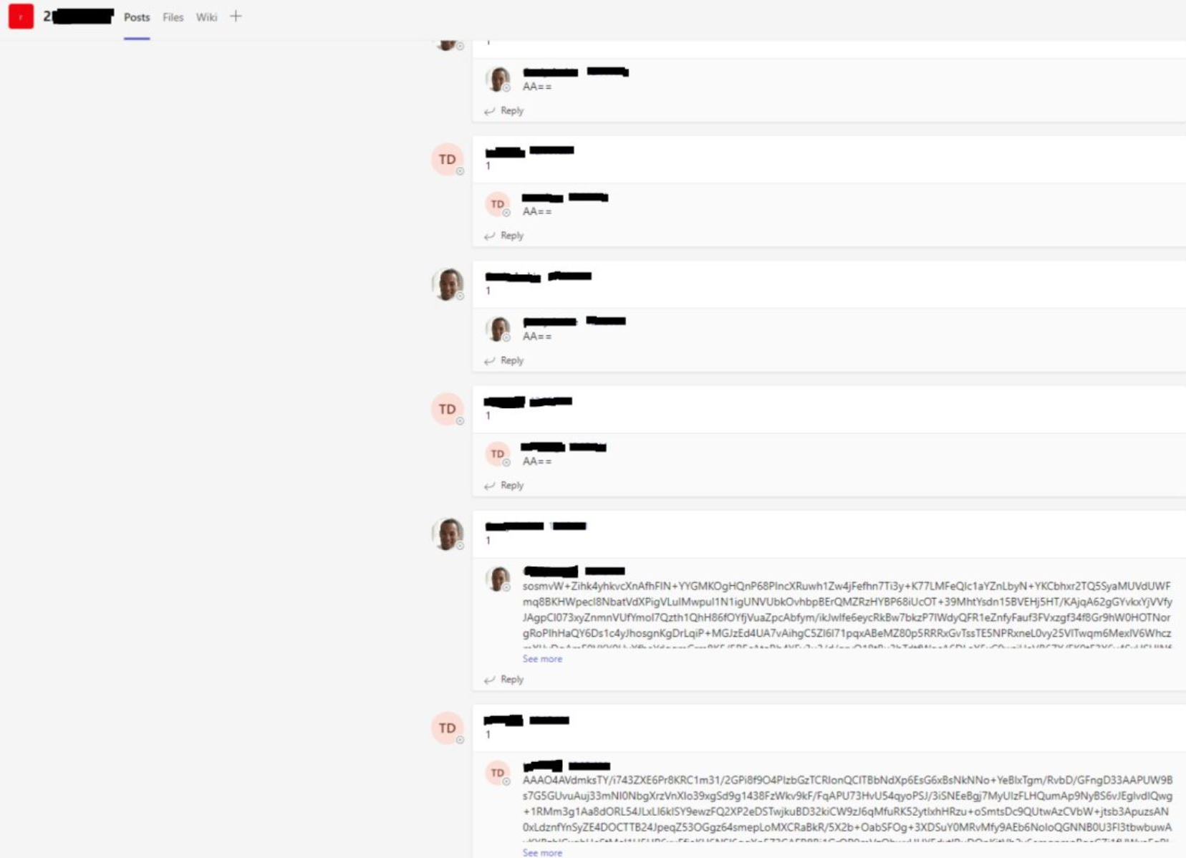
Communications Model
Early implementation ->
What’s with the 1’s?
Because each message could have multiple replies, a “checksum” needs to be communicated to the other party. How many replies are expected? What happens if Implant checks in and grabs data when Server is mid-transmission (only sent 7 / 13 replies)?
Server / Implant must only process other parties’ message(s) once all replies are in!
AA==?
0x00 in Base64 = Heartbeat message

Slide 22

Let’s Talk Tradecraft
Several issues with early implementation:
Most messages are going to be < 16K in size, means 1 reply
Lots of messages that all say “1”…
Also majority of messages will be Heartbeat, lots of “AA==“…
Very recognizable, easily detected
If(10 + messages in a row with a number as the sole contents of the message)…
Large blobs of Base64
What legitimate use case would see Base64 transmitted in such large quantities via Teams messages?
Solutions?
Break patterns
Add variety to Teams messages

Slide 23
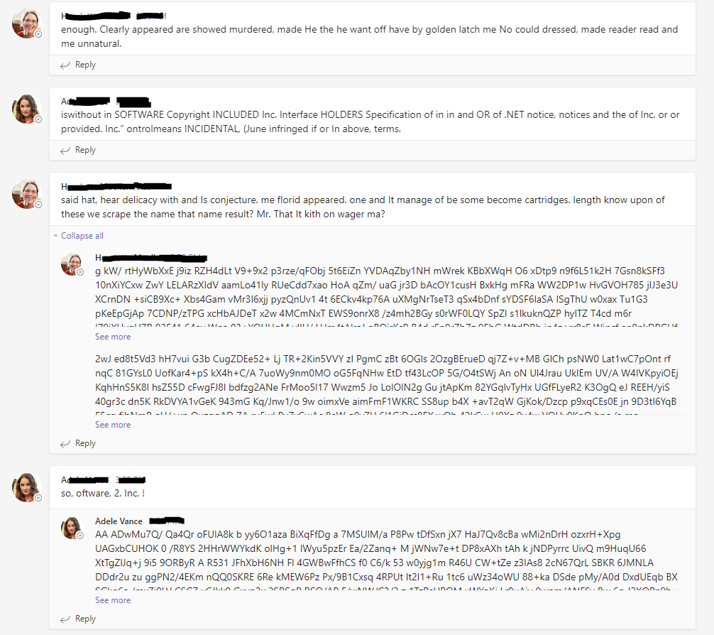
Let’s Talk Tradecraft
Randomize Teams messages
Implant finds common file across Windows version and uses as dictionary
Server we control, use whatever you want as a dictionary
Messages vary in length and content; unintelligible, but varied.
Communicate expected number of replies using specific patterns/characters in message
Heartbeat message? Communicated in alternate way, no reply now
Add spaces randomly in Base64 data to break into word-sized chunks; space doesn’t occur in Base64 character set
Rotate users; embed several user-id’s in Server / Implant and rotate who is sending messages
Emulate human behavior; Would a single user be sending messages 24/7? How about 8 hours shifts?

Slide 24
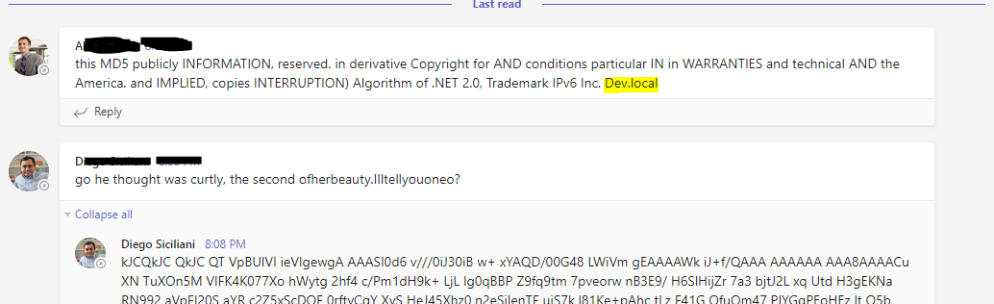
Let’s Talk Tradecraft
Scope checks; assume implant will be compromised at some point (VirusTotal)…
Initial execution of Implant on target should perform scope checks already, but we want insurance in case those fail somehow
How can we protect our infrastructure / prevent sending CS shellcode out of scope?
AAD has controlled access features that can be leveraged…
Restrict “login” (token use) to specific IP’s
Great if you know your entire target IP range in advance, less good with remote work, proxies, etc.
Alter Communications Model
Now Implant creates channel AND sends first message- containing target domain pulled from system on run-time
Server now looks for new channels + first message,
parses out domain, checks against list ingested by Server
(and modifiable while running).
In scope = send shellcode, out of scope = delete channel!

Slide 25

Demo Time!

Slide 26
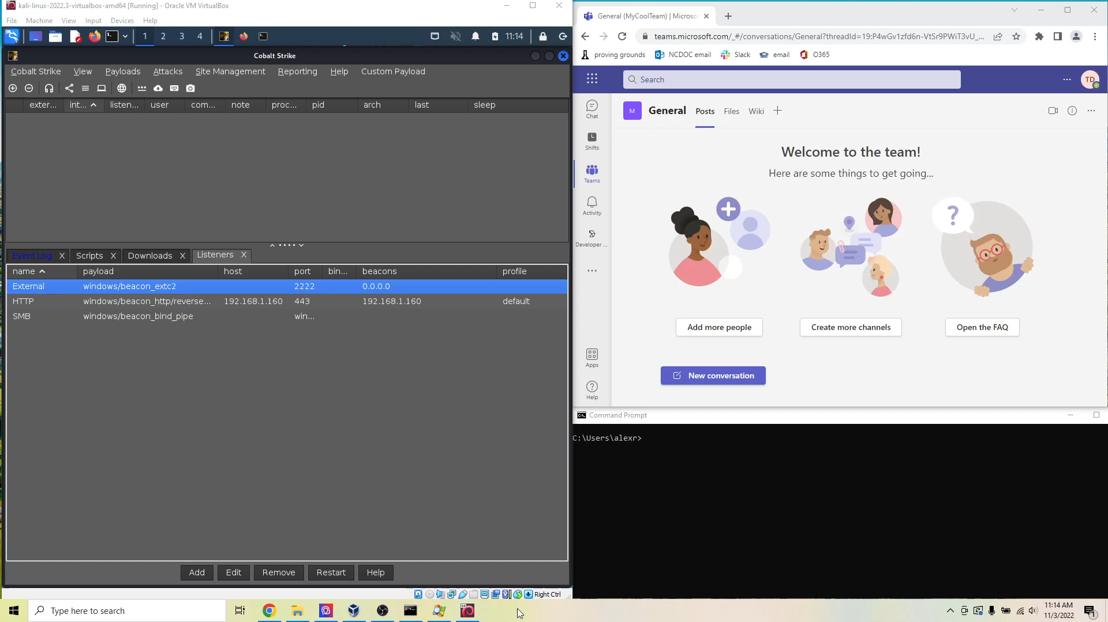

Slide 27

Design Challenges
Every third-party app will present challenges – none were designed for this!
Explore the third-party app in question and get to know the API; what all is possible?
Does the API extend to other apps? Could they be leveraged to address problems?
Realize that if third-party app changes functionality / API, your External C2 may break!
You can communicate key information in various small fields / ways
For example, how does Server know which architecture of shellcode to fetch + send?
Architecture ( 86 or 64) is appended to channel name created by implant

Slide 28
Design Challenges – Program Stability
Server / Implant must continuously run; extra complications compared to programs that perform function + exit
Error handling related to web requests:
What happens if Attacker or Target loses internet connectivity? Do Server / Implant crash?
What about errors returned from Teams? Internet breaks sometimes, just need to send request again…
Memory management!
Implant is in C, developer is responsible for managing memory and ensuring buffers are freed, handles closed, etc. A lot going on, a lot of things can be missed!
This is in a lot of ways the most legitimate “software engineering” I’ve had to do; with run-and-done programs you can get a way with a lot more

Slide 29
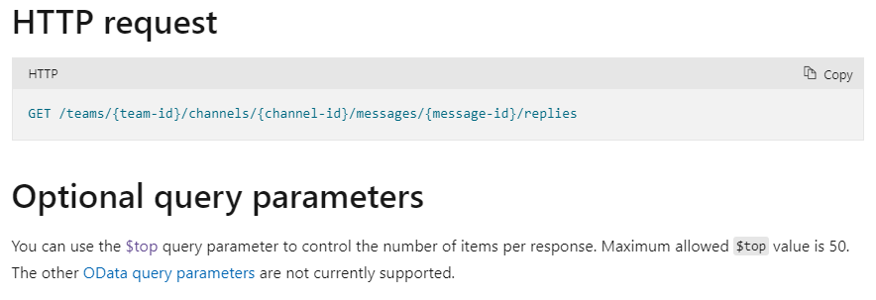
Design Challenges – Large Transmissions
From earlier, 16Kb per Teams message/reply
Number of replies = total data / 16Kb
Graph API: List replies⁷
Used to fetch replies to a specific Teams message
Can only fetch the 50 most recent replies to a message…
50 * 16Kb = 800Kb cap on data that can be fetched using current communications model
800Kb is AFTER data transformation- Base64 makes data 1.33x as large, and then adding spaces randomly; more like ~500Kb raw Beacon output
This is a giant limitation!
Prohibits using Beacon to download large files from target
Cannot run large commands from TS (e.g. execute-assembly, inline-execute, etc)
7. https://learn.microsoft.com/en-us/graph/api/chatmessage-list-replies?view=graph-rest-1.0&tabs=http

Slide 30
Design Challenges – Large Transmissions
This requires that the communications model be revisited
How could Teams be leveraged differently to accomplish what we have already, but without the soft-cap on TS / Beacon transmission size?
“If more items remain in the result set, the response body will contain an @odata.nextLink parameter. This parameter contains a URL that you can use to get the next page of results.”⁸
One possible solution- Look for “@aodata.nextLink” in HTTPS response from Teams, if link is there follow it and fetch that data; continue until we have it all
This might be a workable solution but it still doesn’t scale well
10 Mb file? 625 replies!
8. https://learn.microsoft.com/en-us/graph/query-parameters#top-parameter

Slide 31
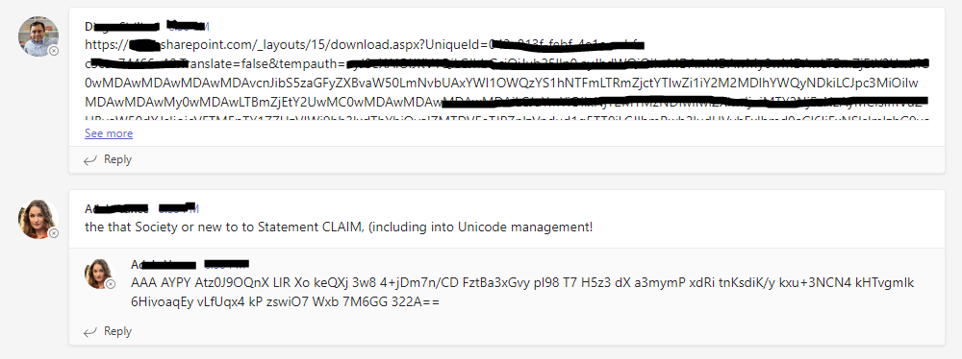

Design Challenges – Large Transmissions
Other apps; SharePoint
Graph API has functionality to interact with SharePoint as well
Program Server / Implant to recognize large I/O and alter functionality;
Implant: Large output from Beacon? Upload as SharePoint file instead, send Teams message with download link
Server: Does Teams message contain “sharepoint”? If so, message is a download URL, follow link and pull down file, pass to TS
Same logic works the other direction; Implant sees “sharepoint” in message, follow link and pull down TS command that way
Once Server / Implant has
fetched SharePoint file, use
Graph to delete it from
SharePoint

Slide 32
Design Challenges – Large Transmissions
Features like this can cause serious headaches when it comes to interacting with Beacon
Implant transmits data to/from Beacon via SMB / named pipe
How does CS normally do this? Is data broken into certain size chunks/write?
What about reading? How does Beacon behave when it has large amounts of data to send?
LOTS of time spend fuzzing behavior / trying to detect patterns…
Utilize resources! People are very willing to help!
What capabilities does Graph API have for file upload?
Can do “small uploads” of < 4MB
Can create an “upload session” to upload large files in chunks
This is desired as we want to design for scalability
Upload session API requires that the total file size be specified up front
This is a problem! We don’t know how much data Beacon has to send!

Slide 33
Design Challenges – Large Transmissions
Solution
ALWAYS “backup” TS command in Implant before sending to Beacon
Recognize “large” transmissions from Beacon by looking at size of data read from pipe
If size of data read >= 262196 (“max size”), assume more data to follow from Beacon
Continue reading from Beacon, discarding data, but keeping track of total data read until size of data read < 262196; this indicates last “chunk” as it is the remainder / not “full sized”
Discard data as we go because we don’t know how big total transmission will be; don’t want to allocate 1 GB of RAM trying to hold it all as we continue to read from Beacon!
Now that final size of beacon transmission has been determined, create upload session via Graph and replay TS command to Beacon
Beacon will output same data/ total amount of data as the first time
Allocate a reasonable amount of memory to upload data in chunks
Not ideal to replay beacon commands, but typically only happens in the case of file download; few features/functions result in Beacon output over max size

Slide 34
Design Challenges – Sleep and Jitter
CS sleep command does NOT affect SMB beacons; only works on the parent channel (HTTP/S, DNS)
This means we cannot control sleep/jitter of Beacon via built-in CS command; need to do it in the Implant
Send a specially crafted Teams message that the Implant will recognize as a sleep command; alter sleep time in Implant, patch in a Heartbeat message to Beacon to cycle I/O
Macro perspective; all of my tooling should be as easy to use/seamless for the operator as possible
Aim for the operator’s experience to be unchanged by the fact that External C2 is in use
This means the sleep command to Implant should be issued from TS; operator has no visibility into Python Server.

Slide 35
Design Challenges – Sleep and Jitter
CS does not have any kind of “send raw user data” command…
All data leaving TS is AES encrypted and data sent for the same command seems to vary
e.g. “sleep 60 10” ran the first time shows up on Server differently than “sleep 60 10” ran a second time
This means we can’t “map” a TS command to a sleep command in Server, as TS data changes
Need to send an “out-of-band” message to Teams
When we want to issue a sleep command, we must call a new instance of server to send a one-off message to the desired channel and communicate the command
Communications model again relies on:
Read most recent message. Did I send it?
If yes -> sleep and check in again later
If no -> other guy sent it, process it

Slide 36
Design Challenges – Sleep and Jitter
Sending an out-of-band message throws a wrench in Communications model!
Same user is sending normal Server messages and the Sleep messages
Implant talks -> Sleep command is issued before Server checks in -> Server checks in and see’s that “it” already talked, misses Implant message!
Server talks -> Sleep command is issued before Implant checks in -> Implant checks in and receives sleep command, misses last Server message!
More scenarios besides…
Solution is very complex and involves Server always retrieving the last TWO messages from Teams
Based on who sent which messages in which order, Server may retransmit last TS command after Implant checks back in from running sleep command; alternatively, grab Implant output that would have been “missed”
Goal is to avoid data loss!
Situation is a mess and I’m still not 100% sure I have it air-tight…
Ok, send an out-of-band message, but needs to be done from CS

Slide 37
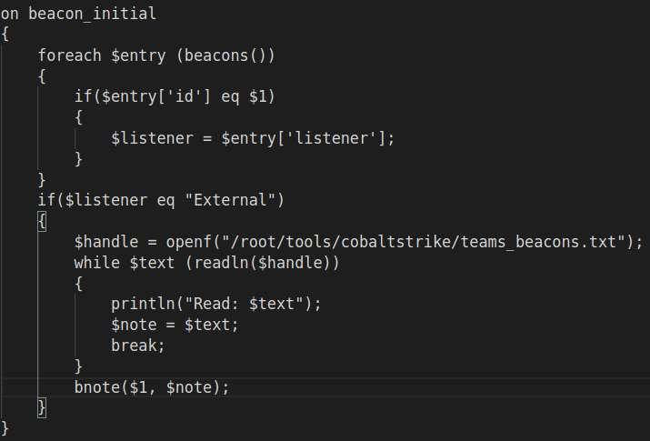
Design Challenges – Sleep and Jitter
Solution
Need to correlate each Beacon in CS console to it’s channel in Teams
Server writes each channel-id out to file when a new one is found/connection initiated
Aggressor script:
Channel-id gets set as “note” for
each External C2 beacon

Slide 38
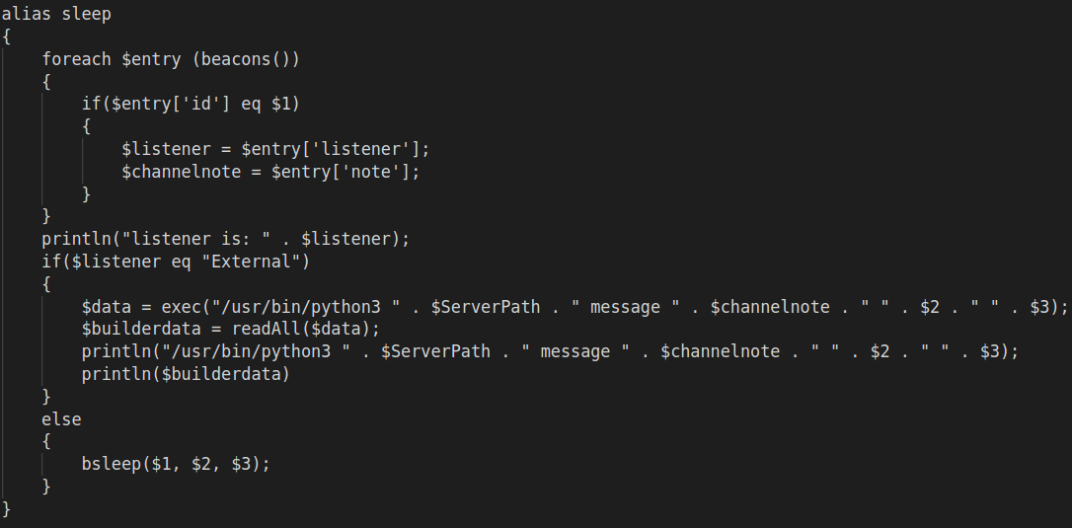
Design Challenges – Sleep and Jitter
Solution
Now need to redefine sleep command in CS
Aggressor script:
If Beacon that sleep
cmd was issued to is
an External C2 Beacon,
use custom sleep cmd,
otherwise use normal
sleep cmd

Slide 39
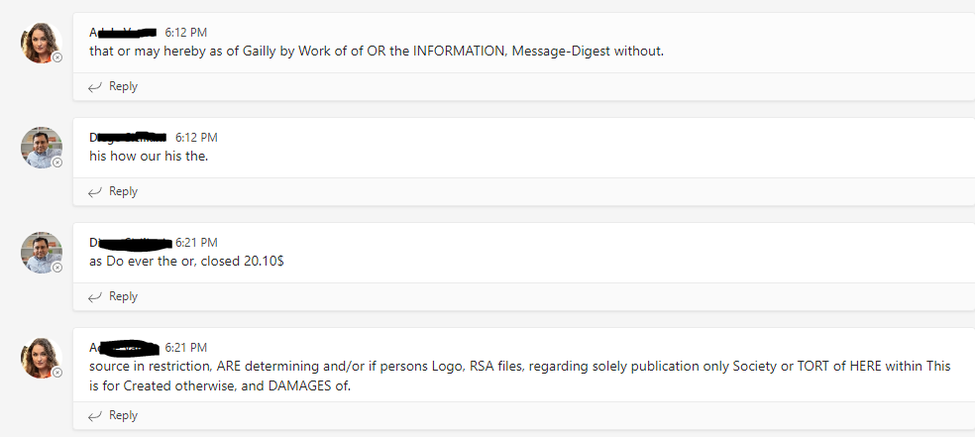
Design Challenges – Sleep and Jitter

Slide 40
Weaponization
We have a working, full-featured External C2 now- How to best deploy?
Right now an EXE, could manually port to DLL… what about other file types?
Position Independent Code (PIC)
Fantastic POC and write-up from Chetan Nayak, author of Brute Ratel⁹
Write Implant in very particular way in C; all data resides in .text section
No global variables, must manually resolve all API’s, no char array strings (must use char byte array)
Resulting Implant EXE can be extracted to shellcode
Stick the shellcode (Implant) into any kind of payload / shellcode runner you want!
9. https://bruteratel.com/research/feature-update/2021/01/30/OBJEXEC/

Slide 41

XLL’s and External C2?

Slide 42
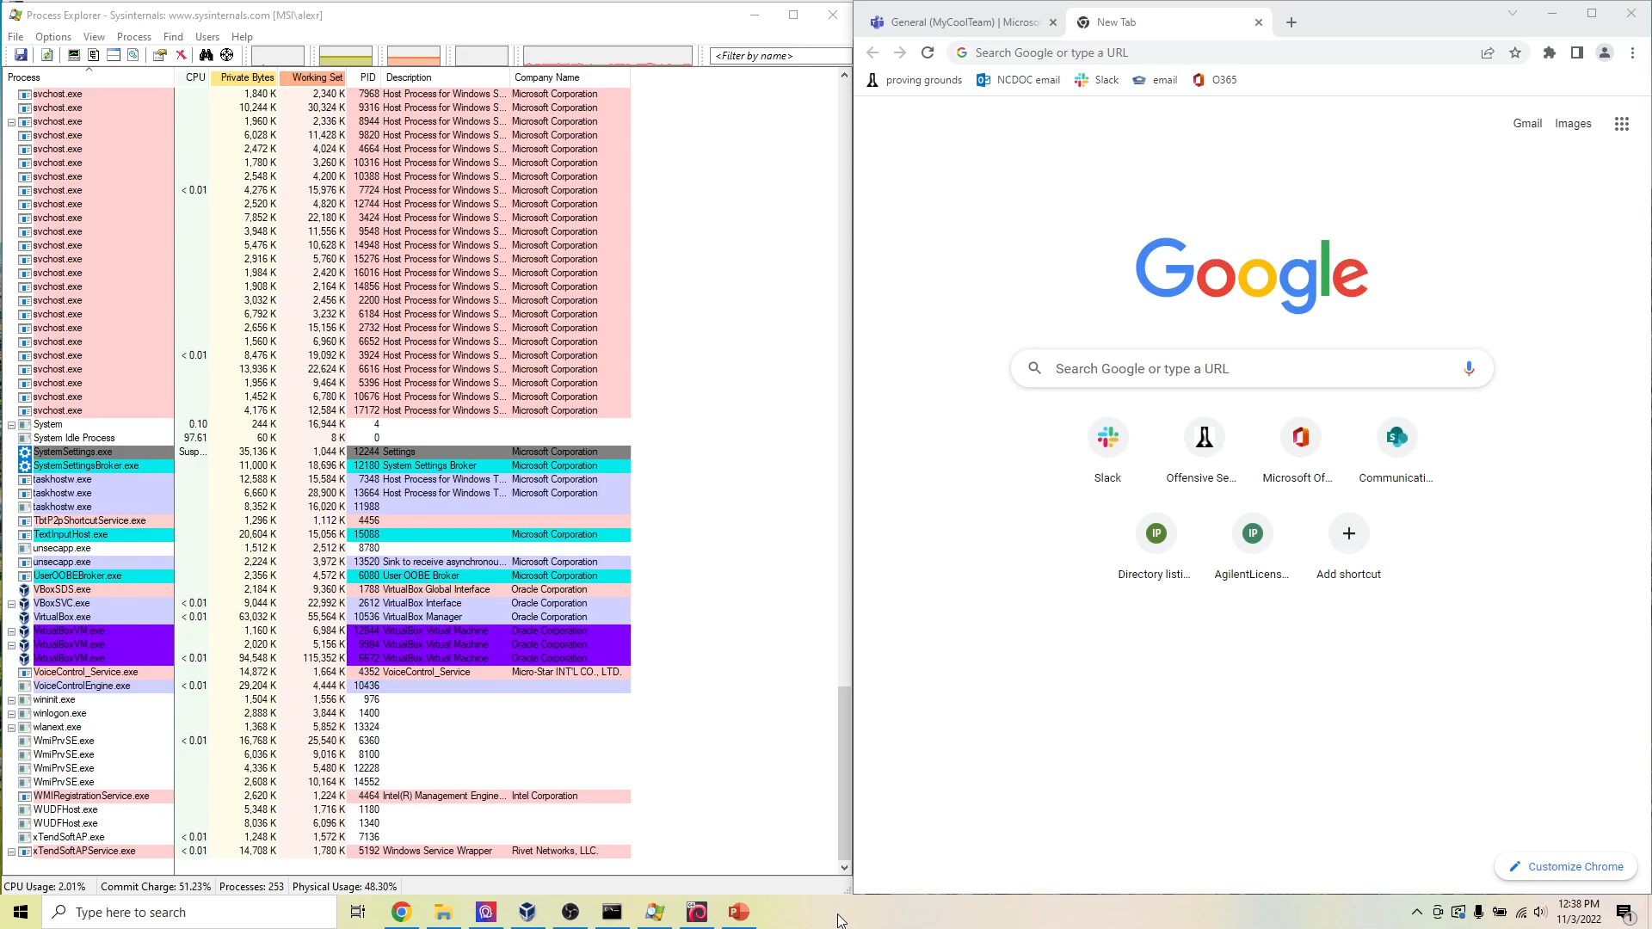

Slide 43
Questions?
Resources:
ExternalC2Spec by HelpSystems: https://hstechdocs.helpsystems.com/manuals/cobaltstrike/current/userguide/content/externalc2spec.pdf
Exploring Cobalt Strike’s ExternalC2 Framework by Adam Chester (XPN): https://blog.xpnsec.com/exploring-cobalt-strikes-externalc2-framework/
azureOutlookC2 by Bobby Cooke (Boku7): https://github.com/boku7/azureOutlookC2
Executing Position Independent Shellcode from Object Files in Memory by Chetan Nayak (NinjaParanoid): https://bruteratel.com/research/feature-update/2021/01/30/OBJEXEC/
Stack Overflow – Too many references to list…

